Slide 1





Geostatistical Modeling of the Risk and Treatment Requirements for Soil-Transmitted Helminthiasis and Schistosomiasis in Kenya: Implications for Programme Activities
Collins Okoyo^{1*}, Wyckliff P. Omondi², Dickson Kioko², Titus Waititu², Stephen Kaliti², Mark Minnery³, Chispin Owaga³, Laban Benaya³, Diana Munanka³, Caren Sande³, Juma Chitavi⁴, Michael Ofire⁴, Milton Bwibo⁵, Mary Maghanga⁵, Stella Kepha¹, Maurice Odiere¹, Elizabeth Otieno⁶, Florence Musalia⁶, Getrude Nasike⁷, Joyce Onsongo⁸, Pauline Mwinzi⁹, Denise Mupfasoni¹⁰, and Charles Mwandawiro¹
Collins Okoyo, PhD ||
Department of Epidemiology, Statistics, and Informatics, Kenya Medical Research Institute, Nairobi, Kenya
Theme: Vector-Borne and Neglected Tropical Diseases
In Search of Better Health
Kenya Health Security Convention | 5th – 8th May 2026 | Mombasa - Kenya

Slide 2
Background & Objectives
  Since 2012, Kenya has delivered consistent, high-coverage mass treatment for soil-transmitted helminthiasis (STH) and schistosomiasis (SCH) to school-age children (SAC) across 27 counties through a school-based deworming (SBD) strategy.
  From 2020, mass treatment was expanded to cover all risk groups through a community-based deworming (CBD) strategy.
  Impact assessment data has been collected by both SBD and CBD programmes, covering the entire 47 counties of Kenya.
  This study collated STH and SCH infection data from the two programmes and fitted a model-based geostatistical (MBG) model to update the infection risk and treatment requirements for STH and SCH in Kenya.

Slide 3
Methodology: Study design, data sources, & sampling
  This was a modeling study using datasets obtained from previous national surveys:
    Survey 1 (Granular, (re)mapping assessment): The survey was conducted in 15 counties between 2020-2021. The survey utilized a multistage sampling technique to granularly sample 5 villages within predefined wards (sub-IUs) within sub-counties (IUs).
    Survey 2 (SPPA, (re)mapping assessment): The survey was conducted in 32 counties between 2023-2025. The survey utilized a multistage sampling technique to granularly sample 4 schools within predefined wards (sub-IUs) within sub-counties (IUs).
    Survey 3 (MBG, impact assessment): The survey was conducted in 27 counties between 2021-2022. The survey utilized a model-based geostatistical approach for its design and sampling. The survey used a spatially regulated sampling approach to sample 200 schools in 27 counties to predict the risk of STH and SCH burden in the entire country.
  The three datasets were assembled, cleaned, harmonized, and used to fit MBG models to predict infection risk and treatment requirements to make a unified programmatic decision.

Slide 4
Methodology: Data types, covariates, & parameters used in the models
Table 1 | Data types, covariates, and parameters used in the model and their sources
No | Data type | Parameter | Source
1 | Epidemiological | Number of sites surveyed | VBNTDU, NSBDP, & WHO ESPEN
2 | Epidemiological | Number of individuals tested | VBNTDU, NSBDP, & WHO ESPEN
3 | Epidemiological | Number of individuals positive | VBNTDU, NSBDP, & WHO ESPEN
4 | Treatment | Treatment coverage | VBNTDU, NSBDP, & WHO ESPEN
5 | Treatment | Number of treatment rounds | VBNTDU, NSBDP, & WHO ESPEN
6 | Covariate | Weighted population at grid level | WorldPop
7 | Covariate | Night-time lights | VIIRS
8 | Covariate | Soil acidity | NASA SMAP
9 | Covariate | Soil moisture | iSDA
10 | Covariate | Enhanced vegetation index | Landsat
11 | Covariate | Elevation | NASA SRTM
12 | Covariate | LST (day) | Climatic Research Unit
13 | Covariate | LST (diurnal difference) | Climatic Research Unit
14 | Distance | Distance to water body | Digital Chart of the World
15 | WASH | Improved water sources coverage | DHS Spatial Data Repository
16 | WASH | Open defecation | DHS Spatial Data Repository

Slide 5
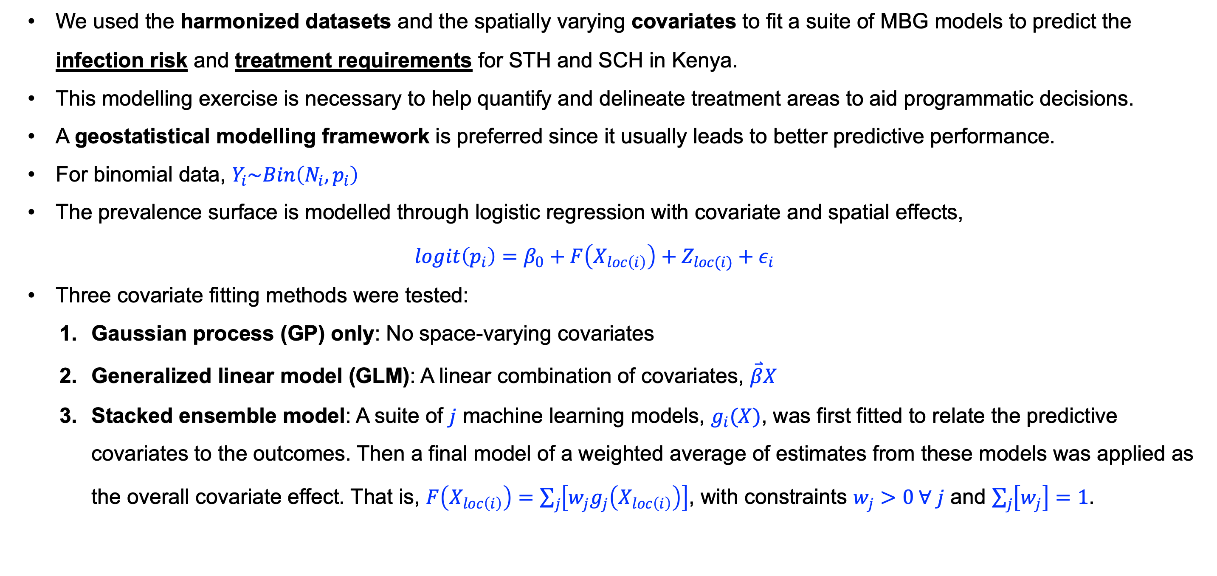
Methodology: Modeling framework & suite of MBG models fitted
  We used the harmonized datasets and the spatially varying covariates to fit a suite of MBG models to predict the infection risk and treatment requirements for STH and SCH in Kenya.
  This modelling exercise is necessary to help quantify and delineate treatment areas to aid programmatic decisions.
  A geostatistical modelling framework is preferred since it usually leads to better predictive performance.
  For binomial data, $Y_{i}\sim Bin\left(N_{i},p_{i}\right)$
  The prevalence surface is modelled through logistic regression with covariate and spatial effects,
  $$logit\left(p_{i}\right)=β_{0}+F\left(X_{loc\left(i\right)}\right)+Z_{loc(i)}+ε_{i}$$
  Three covariate fitting methods were tested:
    Gaussian process (GP) only: No space-varying covariates
    Generalized linear model (GLM): A linear combination of covariates, $\overset{⃑}{β}X$
    Stacked ensemble model: A suite of $j$ machine learning models, $g_{i}(X)$, was first fitted to relate the predictive covariates to the outcomes. Then a final model of a weighted average of estimates from these models was applied as the overall covariate effect. That is, $F\left(X_{loc\left(i\right)}\right)=\sum_{j}{\left[w_{j}g_{j}\left(X_{loc\left(i\right)}\right)\right]}$, with constraints $w_{j}>0 ∀ j$ and $\sum_{j}{\left[w_{j}\right]=1}$.

Slide 6
Methodology: Geostatistical prediction
  The models were fit in an approximate Bayesian framework using the mbg package (v.1.1.0) in R (v.4.3.2).
  After model fitting, 250 posterior samples were generated for each 5x5km grid cell in the study area.
  Summaries of these posterior samples were taken to characterize the mean and 95% uncertainty interval bounds of the posterior predictive distribution.
  These draws were then aggregated to higher-level administrative units (counties, subcounties, and wards), using population-weighted aggregation.
  The aggregation to higher administrative levels preserves uncertainty in the estimates.

Slide 7
Results: STH prevalence
Table 2 | Mean overall prevalence estimate for soil-transmitted helminthiasis using three different covariate fitting methods within MBG suite
MBG model type | Mean prevalence (%) | 95% UI | RMSE*
GP only: Any STH A. lumbricoides Hookworm T. trichiura | 4.46 3.21 0.87 1.45 | 3.70-5.61 2.46-4.24 0.63-1.18 1.09-2.10 | 0.0651* 0.0473* 0.0186* 0.0408*
GLM: Any STH A. lumbricoides Hookworm T. trichiura | 5.98 4.73 1.43 2.38 | 3.71-9.70 2.61-8.61 0.75-2.96 1.25-4.73 | 0.0656 0.0478 0.0190 0.0409
Stacked ensemble: Any STH A. lumbricoides Hookworm T. trichiura | 5.11 4.35 1.22 2.12 | 3.42-7.65 2.55-7.19 0.49-2.63 1.26-3.65 | 0.0654 0.0479 0.0187 0.0408
*The model with the least out of sample RMSE was the best model chosen for subsequent analysis for STH. In this case, GP only was the best model.

Slide 8
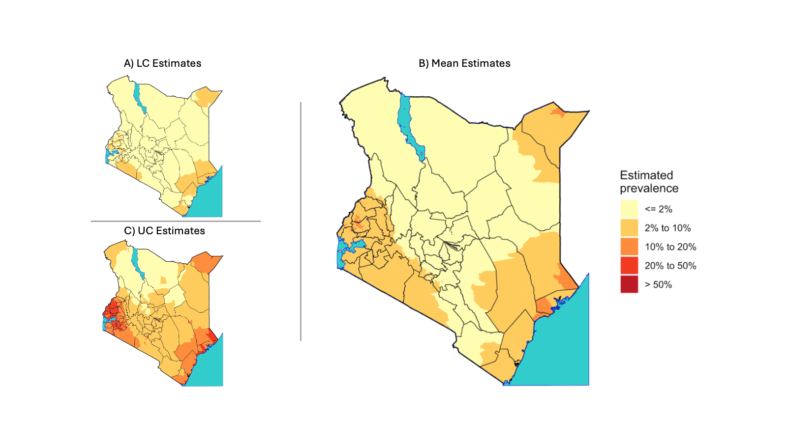
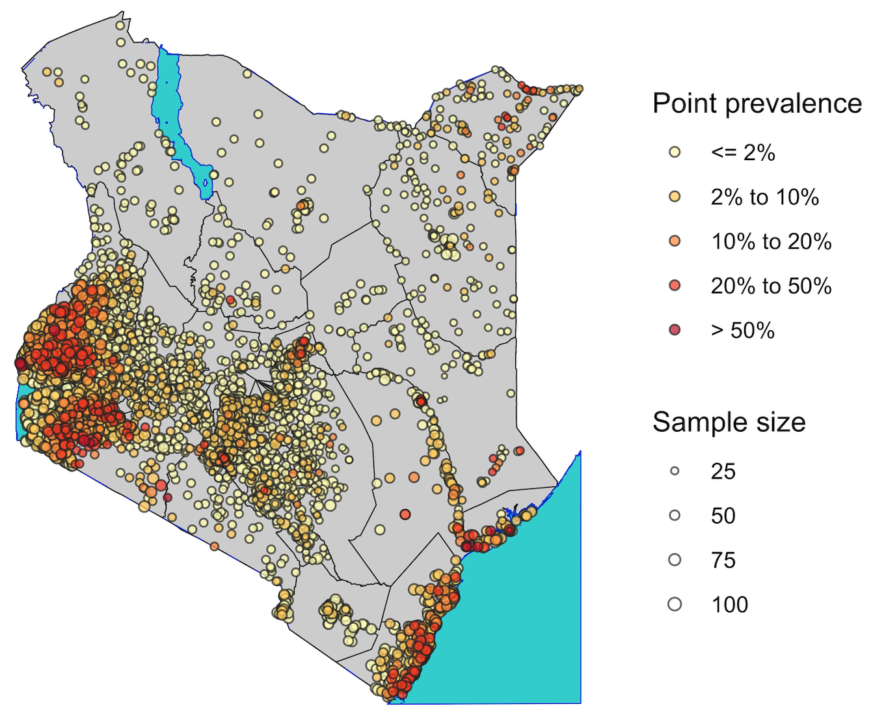



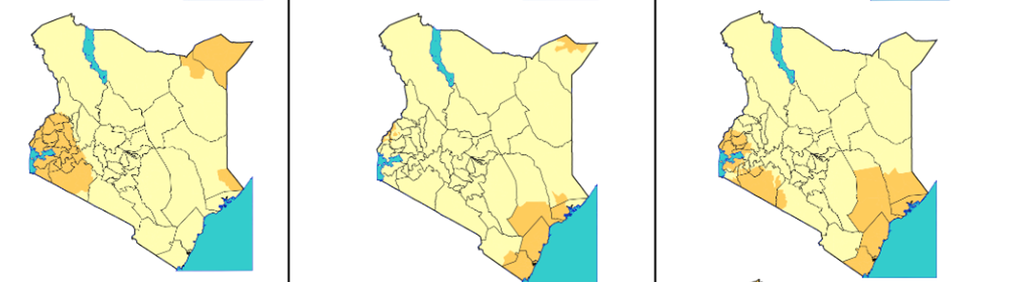
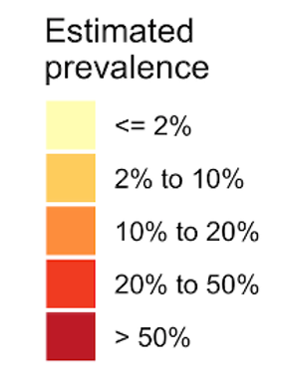
Results: STH prevalence risk prediction
B) Predicted any STH prevalence: GP only within MBG suite
A) Input data
  Panel A shows locations where epidemiological data were collected
  Any STH (panel B) risk is observed in western, coastal, and pockets of northeastern parts of the country
  A. lumbricoides (panel C.A) risk is higher in the western and pockets of northeastern region of the country
  Hookworms (panel C.B) risk is confined to the coastal strip of the country
  T. trichiura (panel C.C) risk is widespread in the western and coastal parts of the country
C) Predicted STH species prevalence: GP only within MBG suite

Slide 9
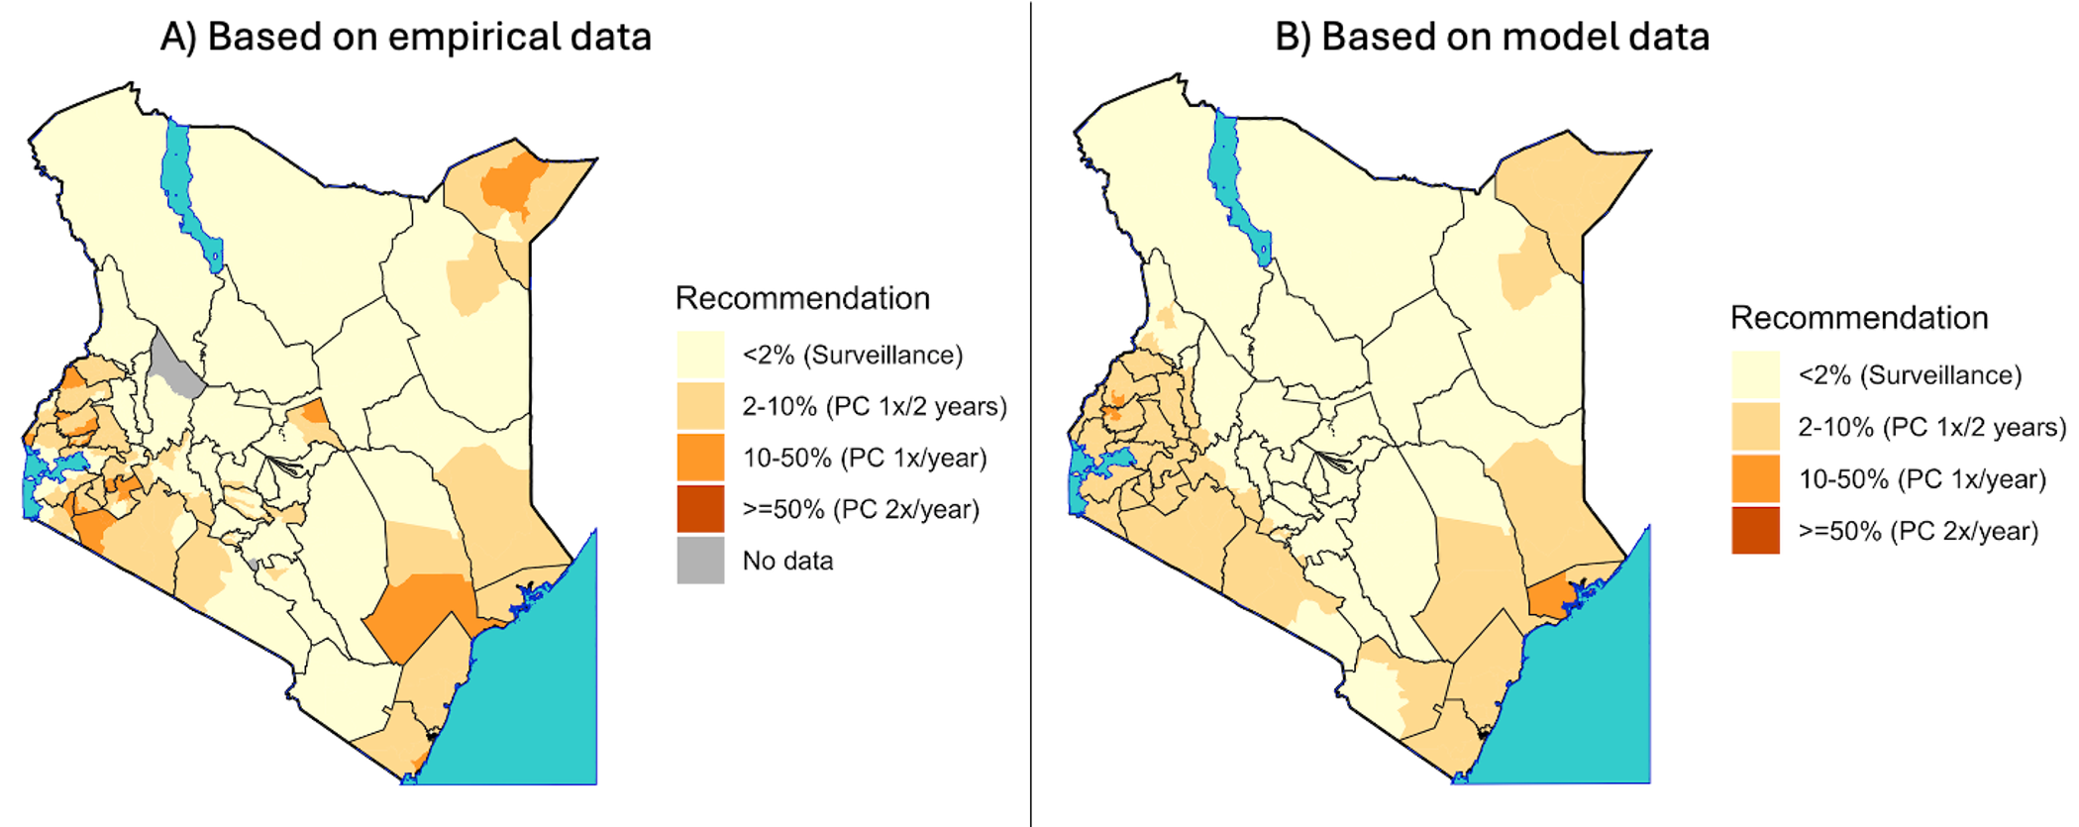
Results: STH treatment requirement prediction
The model accurately predicted treatment requirements for any STH compared to the empirical data.
From panel B, we see that making a treatment decision based on model (GP only) data is as accurate as making a decision based on empirical data (panel A).
Most IUs are predicted to be under surveillance for any STH.
Few IUs, mostly in the western and coastal regions, require treatment once per year.
None of the IUs were predicted to require treatment twice a year.

Slide 10
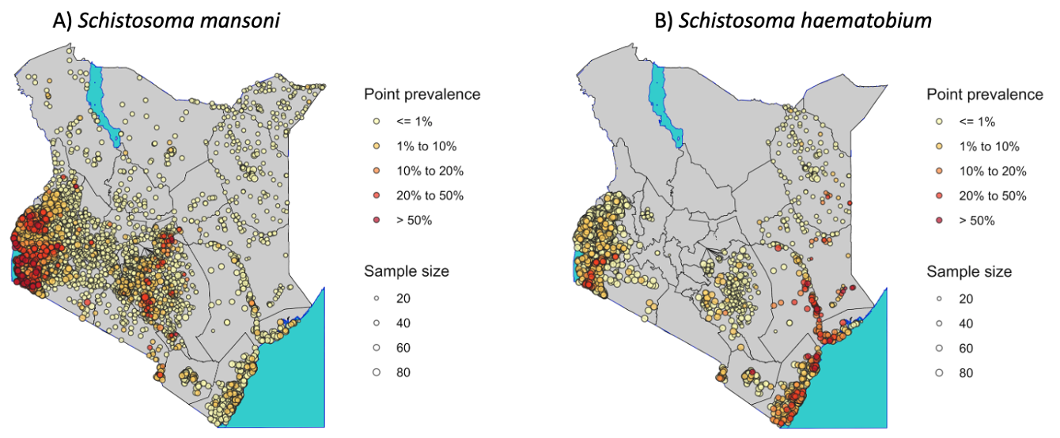
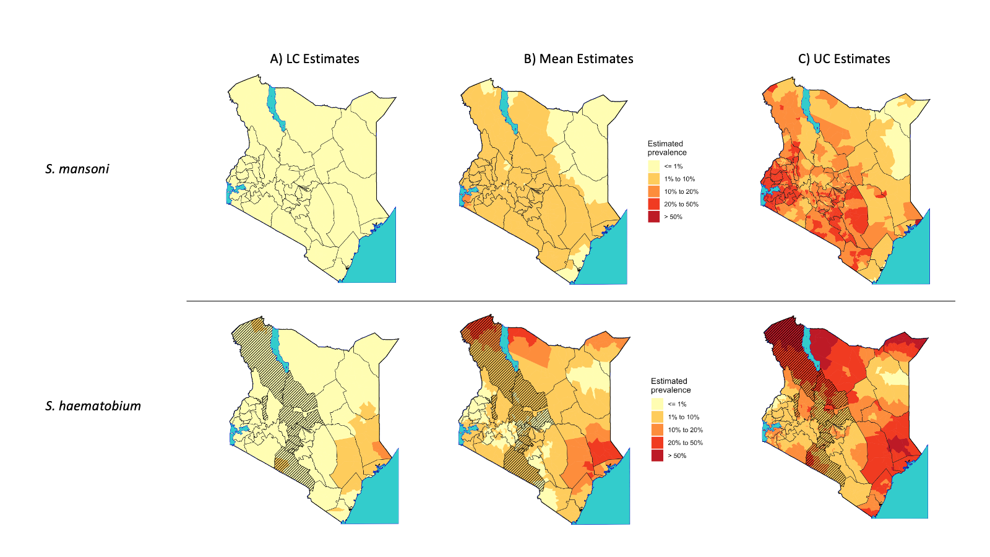
Results: SCH prevalence & prevalence risk prediction
Table 3 | Mean overall prevalence estimate for schistosomiasis using three different covariate fitting methods within MBG suite
MBG model type | Mean prevalence (%) | 95% UI | RMSE*
S. mansoni
GP only | 5.20 | 2.84-11.25 | 0.0839
GLM | 4.85 | 2.68-7.90 | 0.0833
Stacked ensemble | 3.43 | 1.71-6.34 | 0.0824*
S. haematobium
GP only | 1.81 | 1.18-2.76 | 0.0620
GLM | 5.20 | 3.07-8.06 | 0.0621
Stacked ensemble | 2.40 | 1.43-4.19 | 0.0616*
*The model with the least out of sample RMSE was the best model chosen for subsequent analysis for SCH. In this case, Stacked ensemble was the best model for both species of SCH.
Predicted prevalence
  S. mansoni hotspots are observed in the L. Victoria strip and low risk in other parts of the country
  S. haematobium hotspots are observed in Tana River delta, coastal strip, and low risk in other parts of the country

Slide 11
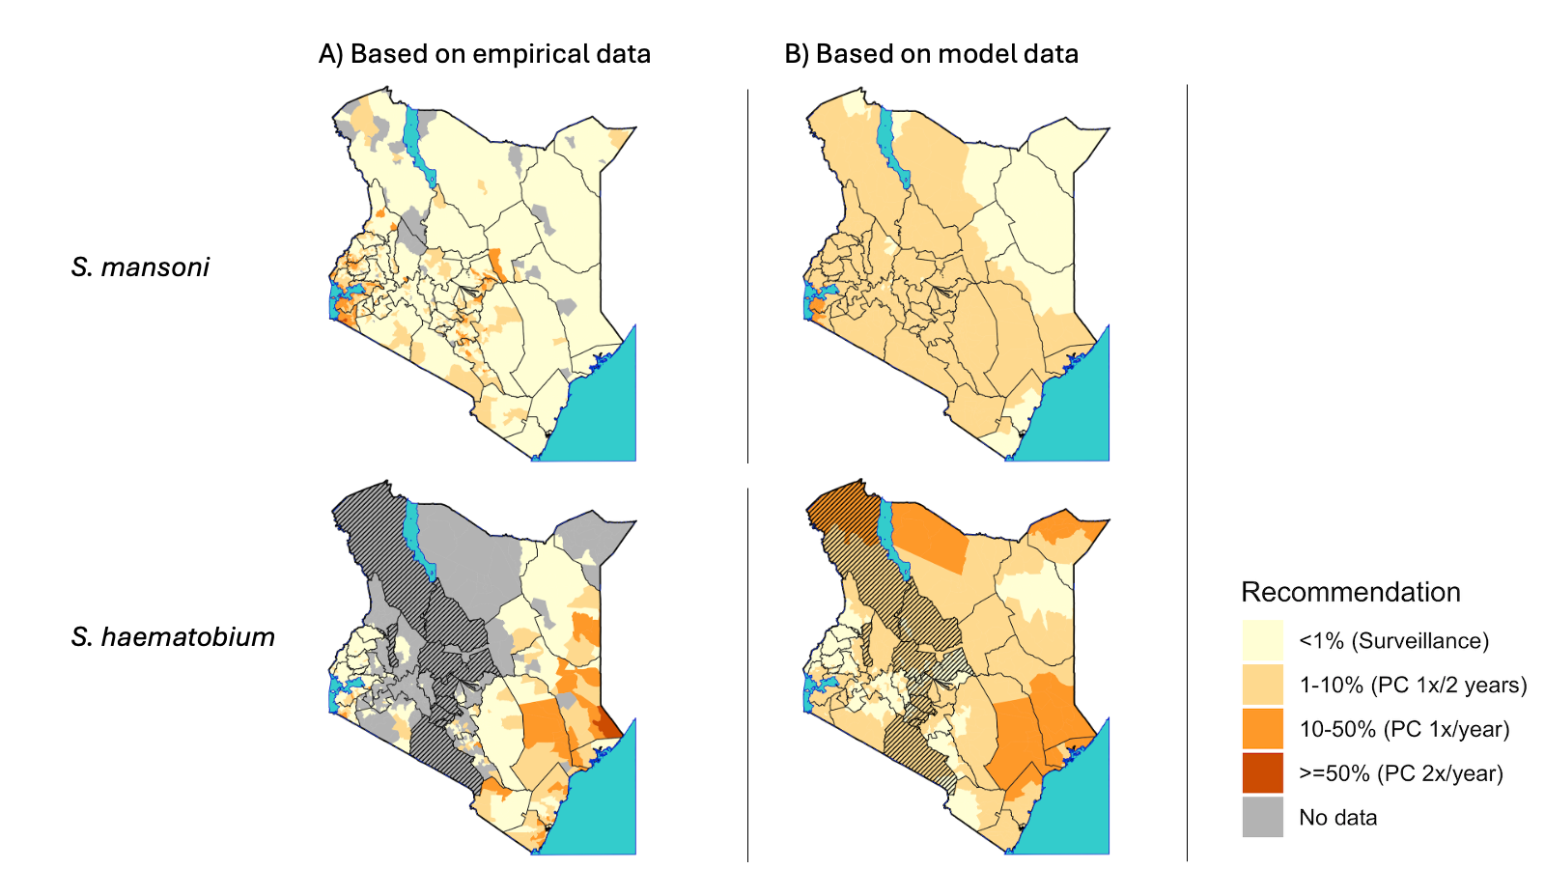
Results: SCH treatment requirement prediction
For both SM and SH, the model optimally predicted treatment requirement in areas with sufficient data.
In areas with localized prevalence or no/sparse data, the prediction was suboptimal.

Slide 12
Conclusion
  The model efficiently predicted the STH and SCH infection risk throughout the country.
  However, for SCH, caution must be taken before using modeling to make definitive treatment decisions since limited data or prevalence localization will affect the prediction. But the model can be used to prescribe where SCH treatment is warranted.
  For STH, the majority of IUs are predicted to be under surveillance, no IUs require treatments twice a year, and only few IUs require to be treated once per two years or once per year.
  For SCH, the model optimally predicted treatment requirement in areas with sufficient data. However, in areas with localized prevalence or no/sparse data, the prediction was suboptimal.

Slide 13
Policy Impact and Implications
  Interventions should be species-specific and target areas where risk is high.
  Results from the modelling data can be used to make treatment decisions for STH, even in areas with no/limited data.
  Given that 125/300 of the IUs and 498/1390 sub-IUs are currently predicted to be under surveillance, with many others requiring reduced treatment frequency, this indicates that an effective surveillance strategy is needed.
  Further, the country requires a rigorous assessment of elimination as public health problems for STH and SCH.

Slide 14

Thank you!
Scan to visit our website
#KeHSCon2026
@NPHIKenya
www.nphi.go.ke

